Slide 1
Know the business
Team name : 2 sharks
Team leader: vikas kumar(ui22cs85)
Team member: jha Sudarshan raman(ui22cs30)

Slide 2
Business of renting Centering plate and selling of Centering plate
maa krupa centering plate depo
Name of owner – mr.Dharmesh Bhai Ahir
Qualification- diploma(textile engineering)
Experience-(sales man & supervisor)
Mobile no-9033990941
Location : Valthan , Near SUV INTERNATIONAL SCHOOL , NEAR NH- 48 , SURAT , GUJARAT

Slide 3
Description of the Business
Established: Founded in 2017
Legal Structure
Legal Structure: Sole Proprietorship
Legal Obligations: Compliant with all local and national regulations.

Slide 4
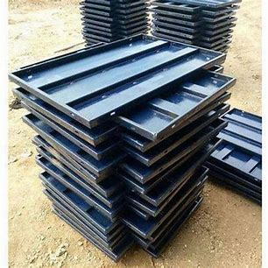
Description about the Products
Centering Plates

Slide 5
Uses of products
These plates are primarily used for construction work, these are used to Mould and shape the concrete during construction.
They provide a stable and even surface for pouring concrete, and it helps the concrete to take its desirable shape.
Centering plates are commonly used in the construction of slabs, beams, columns, and walls, facilitating the creation of precise and uniform concrete structures.
They help distribute the weight of the concrete evenly and offer temporary support until the concrete cures and hardens, ensuring structural integrity.

Slide 6
Products features:-
These plates are reusable, and very cost – effective
Centering plates are typically made of steel, aluminum, or other durable materials that can withstand the weight and pressure of wet concrete.
They are available in various sizes and dimensions to accommodate different construction requirements.
Many centering plates are treated or coated to resist corrosion, ensuring longevity and reliability.
Product material is long lasting so if I can buy at once than I can earn a good living out of this for a long time
There is no need of buy new product because this is long lasting products

Slide 7
How to make money from this business
These centering plates are offered for rent to contractors, who construct buildings and houses.
This business also buy plates at cheaper rates and sell it in profit to other buyers.
charge 1 rs/plate/day as rent to the customer at now time and 5 rupees/plate maintenance charge of the plate

Slide 8
Business history
After leaving 7 jobs at the end of 2017, and then enter in this business in order to make more money for his family.
Starting stage of business:
Starting from 350 centring plate
Starting investment:
At that time per new plate cost is 36 rupee per kg
Total invest money=total no of plate x one plate weight x iron cost rate
Total invest money=350x12x36
Total invest money=1,51,200 rupees

Slide 9
Starting business strategy to enter the market
First, We have to know about this business market. It helps us to identify the other businesses of the same thing.
There is total of 127 centering plate business in Surat. We have to open our shop in that area, in which you are the only one in that business, which will help you to grow your business rapidly.
Supply visiting card for knowing people.
In starting of the business, We need to lower the price of our product by some amount to gain the customers.
contact more contractor and people and influence them.
Make a good relation with contractor and builder and many other of people.
At the starting when market rent of Centering plates was 80 paise/ plate , but we lowered our rent rate to 70 paise/plate.
In this business, There is no chance of loss. We need to reach the customers and rent as much plates as we can, So we can buy more plates and increase our profit drastically.

Slide 10
Cost which is paid by the customer
Maintainance charge =5rupees/plate
rent charge= total no of plate x rate of plate x no days
Total charge=(total no of plate x rate of plate x no days) + (maintenance charge/plate x no of plate)
profit and loss selling business
Weight of plate is 5.5kg(small plate) and 12.5(big plate)
material cost per kg=84 (including 18% GST)
total cost price per small plate= material cost per kg x 1 plate weight
total cost price per small plate= 84x5.5=462 rupees
total cost price per big plate= 84x12.5=1050 rupees
selling price of the small plate is 500
selling price of big plate is 1200
profit in small plate is =500-462=38
profit in big plate is =1200-1050=150

Slide 11
Profit percentage in small plate is =(profitx100)/cost price
=(38x100)/462=8.22
profit percentage in big plate is =(profitx100)/cost price
=(150x100)/1050 =14.28
Revenue in best condition when all plate is at rent
Now total no of plate is 6500 for rent
Revenue=total no of plate x per plate cost per day
Revenue=6500x1rupee/day
Revenue per day is 6500 rupees
in starting time per per revenue was 245 rupees per day
how much expand business=6500/245=26.53
business is multiplied by 26

Slide 12
Generally avg 6000 plate is at the rent and a costumer take plate for a month
Room rent of the business is 5000 per month for one room and 3000 per month for other room
Revenue for one month=(total no of plate x per plate cost per day x 30) +(maintenance charge/plate x no of plate)
revenue=(6000x1x30) + 5x6000
revenue=180000+30000
Revenue=210000 per month
expenditure=room rent per month+ charge for maintain the plate
expenditure=5000+3000+(maintain charge per plate x no of plate)
expenditure=5000+3000+3x6000
expenditure=26000
total profit=revenue-expenditure
total profit= 210000-26000
total profit= 184000per month

Slide 13
Target audience: Target the contractors and the contractors who arev involved in Government contracts, so you can get large orders.
At this point, the owner is in contact with total of 34 such Contractors.
How to handle the typical customer:
Many a times, you have to face new customer, as we don’t know the customer, We need to be cautious regarding our goods and money. We need to take advanced payment for our material, i.e., Material cost and return it when the customer comes back with the plates. There could be customers, who can fraud you, and sometimes take your goods far to other state. So that’s why its also necessary to take i9dentity proof of that customer.
Take his Aadhar card as a proof and also take a blank cheque for security purpose.
Also Contact a middle man to take responsibility for it, on whom you can trust, and he could take responsibility of the customer.
Some times costumer does not want to give money, You need to be up to date with your sellings and purchase, You need to contact the customer frequently, so that you can get your payment on time.
There could be another case, in which, if the plates get damaged or lost by the customer, then, We charge the customer with the actual price of the plates, it depends if the customer is trustful person, you could charge somewhat lesser. Because, you need to maintain good relation with the customers.

Slide 14
Vision:-
Mission:-In short term, He wants to expand the current business in other word willing to increase more and more plate
In long term vision is to fulfill majority needs of the customer, by selling products which are related to construction, so that customers would get benefit, and you can also have profit.
Risk and problem in the business:-
Many times he has to remind to costumer to pay money after complete date of rent.
Some times it is very difficult to retrieve money from criminal type person, then we need to think for our safety, and sometimes in this case, we face loss also.
There is so many competitor in in the business there is 127 competitor in this business specially In surat.
It is very difficult to compete with those businessman who have large business in compared to our business.

Slide 15
Suggestion:-
Try to expand business earlier means in starting phase work hard and atleast stable your business in less time and after your business is stable then try to expand your business slowly-slowly or according to you.
Communication is most useful weapon in the business, it is necessary to work on communication skills to attract the customer.
After your first business is going on in proper way then try to make another business in another sector and try to make at least two business which can be your source of income Because if one business is in recession then other can be your financial backup otherwise, sometimes you will be in financial crisis if your all business mean only business is in recession.
Most important suggestion is business is very very important but not everything so try to spent at least 7/12th day time with your family after stabilizing the business not initial stage of the business.
Try to separate business life and personal life.
Business is something about risk so you have to be patience and control your emotions.

Slide 16
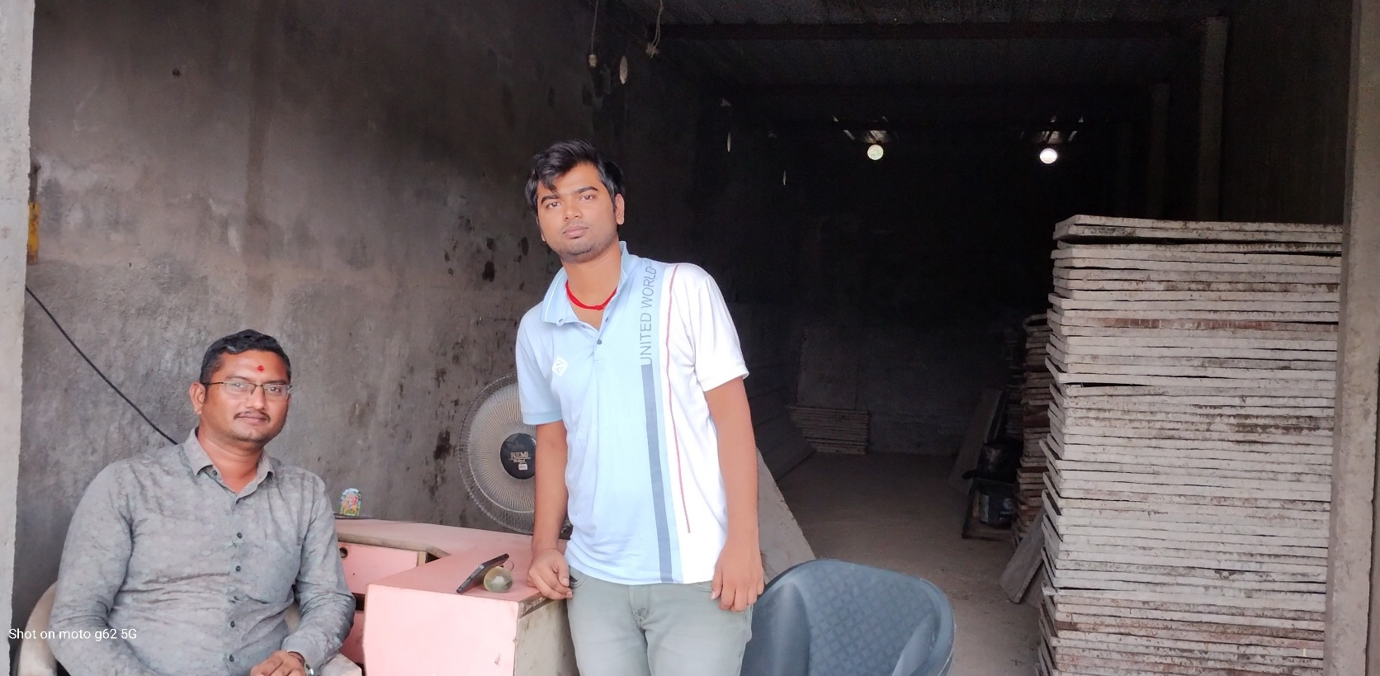
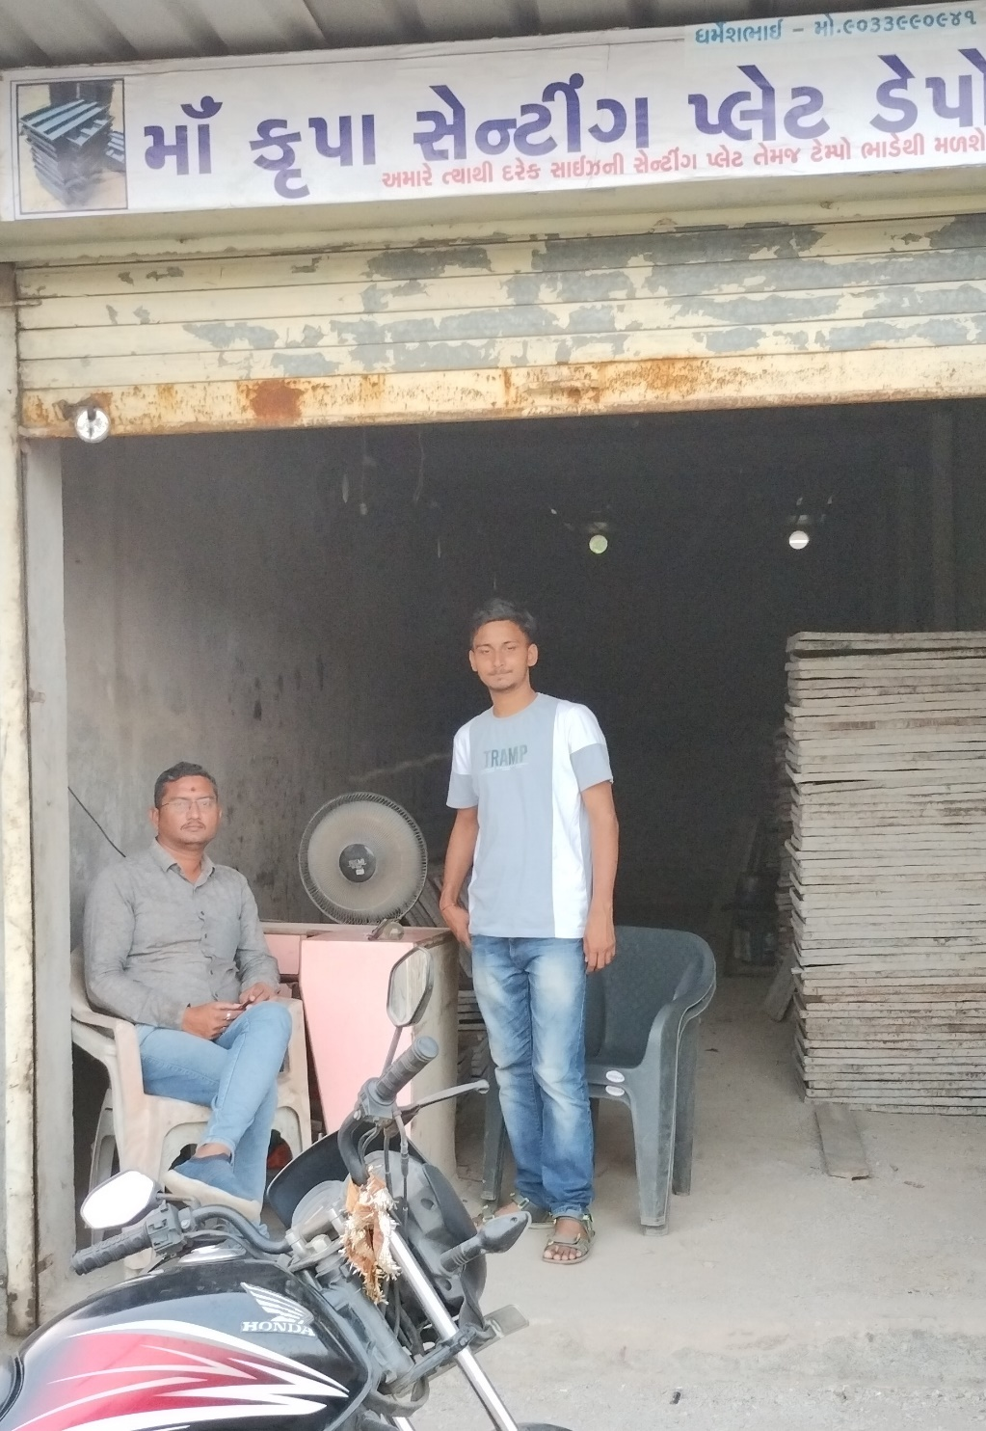
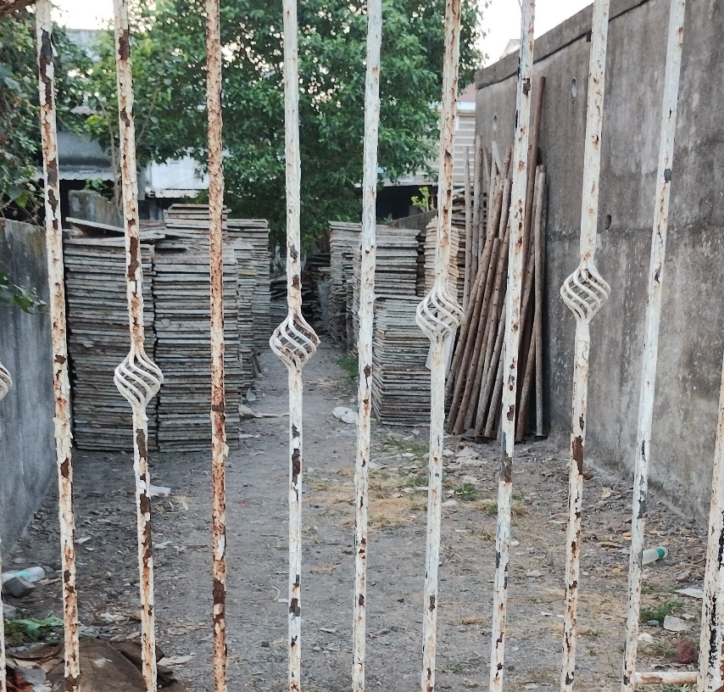
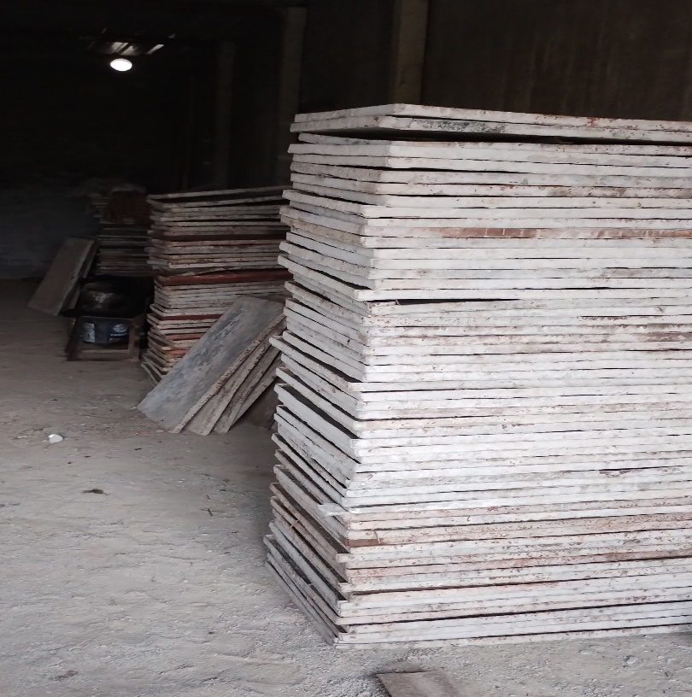

Slide 17
Thank you

